Slide 1
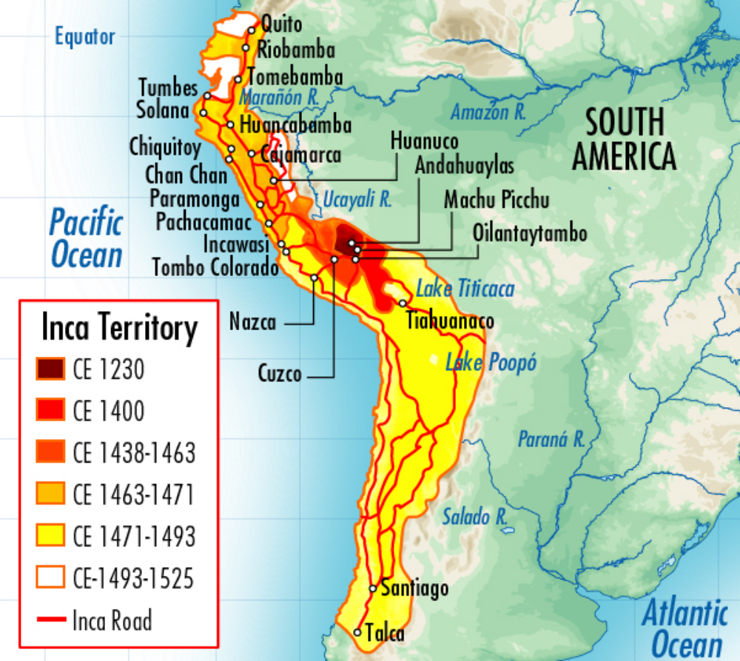
Rise of the Inca
In 1438, the Kingdom of Cuzco was established in southern present-day Peru
Campaigns of expansion continued for nearly 100 years
Reached its apex by 1525 with a population of about 14 million

Slide 2
Rise of the Inca
In 1438, the Kingdom of Cuzco was established in southern present-day Peru
Campaigns of expansion continued for nearly 100 years
Reached its apex by 1525 with a population of about 14 million

Slide 3
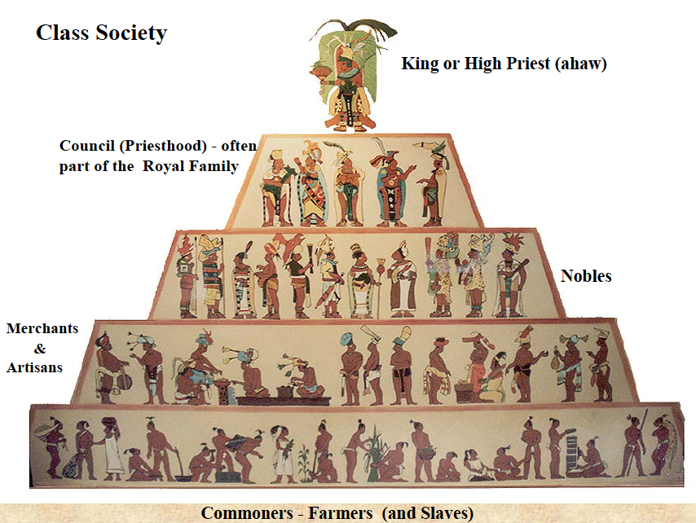
Incan Society
Power was very centralized
Chief ruler, or Sapa Inca, viewed as a god-king, descendant from the sun
Priests were among the elite class
No large merchant class
Peasants supplied food stuffs and labor for public works

Slide 4
Incan Society
Power was very centralized
Chief ruler, or Sapa Inca, viewed as a god-king, descendant from the sun
Priests were among the elite class
No large merchant class
Peasants supplied food stuffs and labor for public works

Slide 5
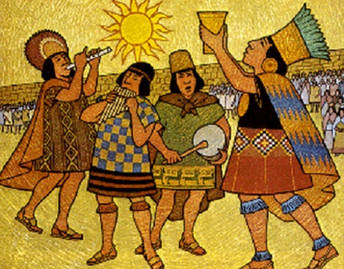
Incan Empire
Traded throughout the region
No internal market system
Practiced polytheism
Practiced mummification of the elite class
Practiced human sacrifice

Slide 6
Rule of the Empire
Divided in to four large districts and smaller sub – districts with a local governor
Local rulers remained in power as long as they supported the Inca
Colonized and spread their language as a way to integrate the empire
Required labor services from all captured or conquered peoples

Slide 7
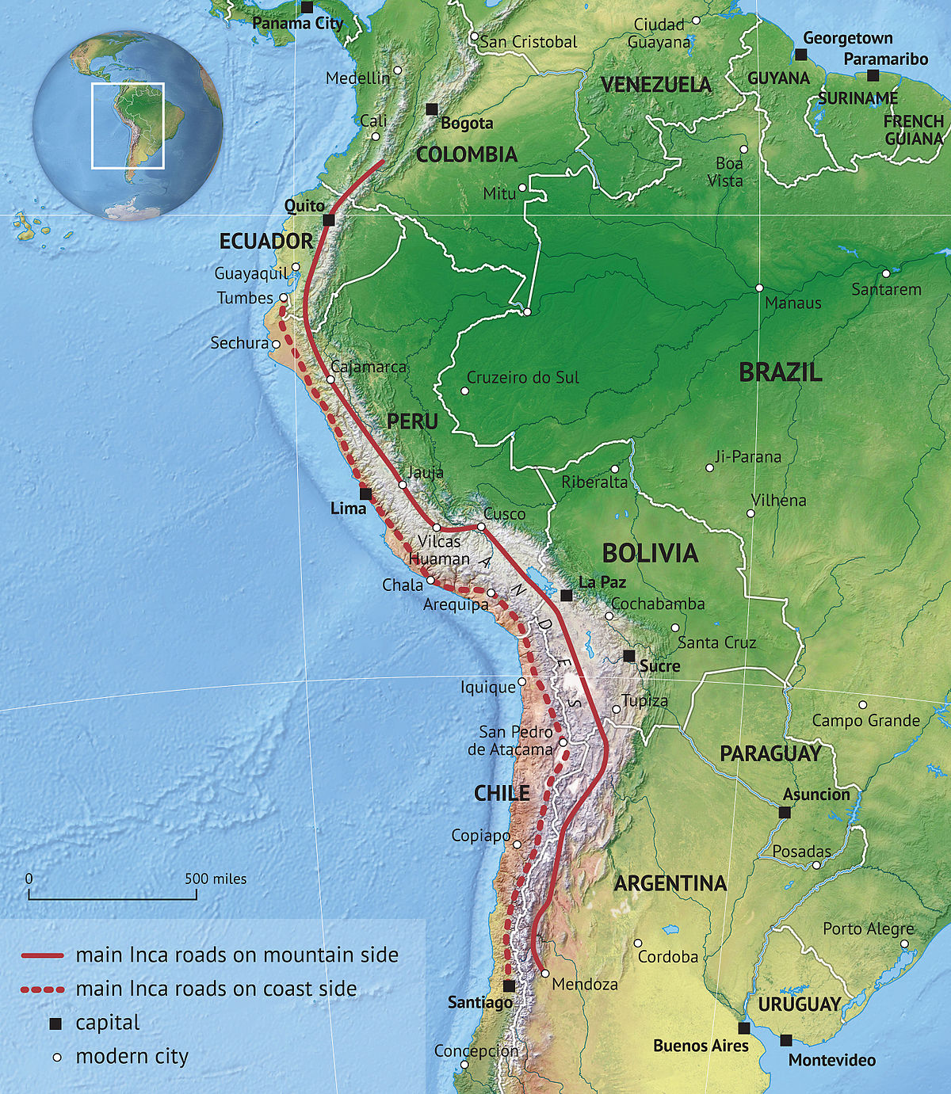
Incan Road System
Stone roads extended nearly 25,000 miles throughout the empire
Nearly 10,000 supply / relay stations was one day’s walk apart
A message took 9 days to travel the length of the empire

Slide 8
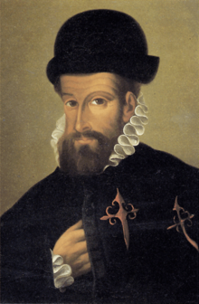
Fall of the Inca
Spanish under Francisco Pizzaro encounter the Inca in Peru in December 1530
The Inca were weak due to civil war and a smallpox epidemic
In November 1532, Pizzaro defeated the Incan army and captured Atahualpa, the Incan ruler
In 1534 Pizzaro captured the Incan capital, Cuzco

Slide 9
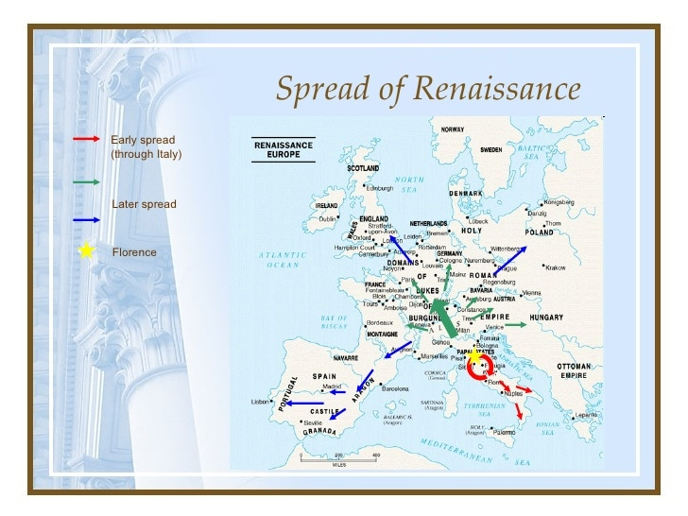
The Renaissance
Began in Florence, Italy in the late 14th century
Resurgence of interest in the arts, sciences, medicine, music and politics
Spread across Europe by the 16th century
Led to the breakdown of the feudal system in Europe

Slide 10
The Renaissance
Transition period from a medieval to a more modern Europe
Occurred during a period of religious turmoil in Europe
Advancements in the arts, mathematics, sciences and medicine
Introduction of humanistic ideas
Spread across most of Europe by 1495

Slide 11
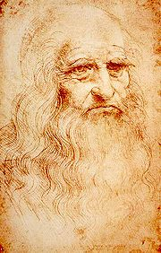
Leonardo da Vinci
(1452 – 1519)
Examined many fields, including art, mathematics, and sciences
Dissected corpses to study human anatomy and made drawings of his findings
Made drawings of airplanes, tanks and parachutes
Kept daily journals on his findings and ideas
Painted the Mona Lisa and the Last Supper

